Slide 1
Generating Reciprocal Structures with ABxM
Jonas Mertens & Likhinya Kvs

Slide 2
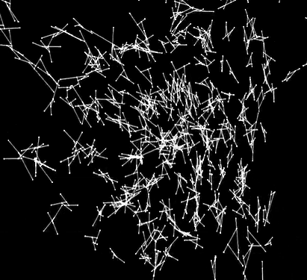
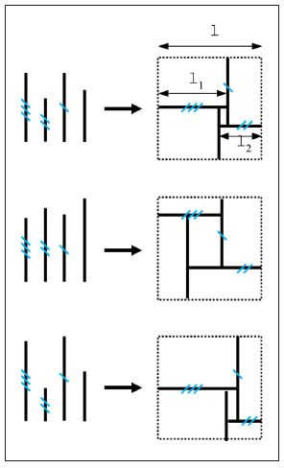
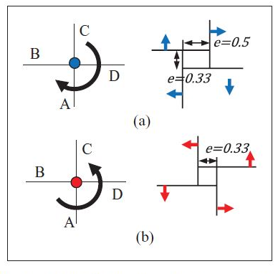
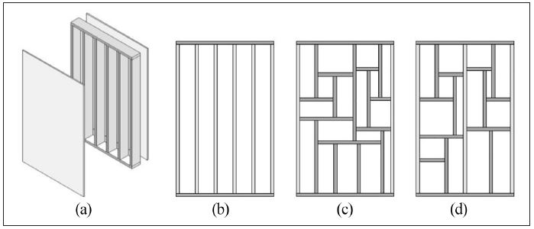
State Of Art
Lamella Flock by
Martin Tamke Cita & Royal Danish Academy
(2010)
Minimal-waste design of timber layouts from non-standard reclaimed elements: A combinatorial approach based on structural reciprocity by Dario Parigi (2021)
Notes:
Our goal was to design an agent-based system to create reciprocal structures using reclaimed timber stock.
We examined projects that employ agent-based modeling for reciprocal structures. For example, the Lamella Flock project develops reciprocal geometry by positioning an initial quadrilateral node in space, which then moves, orients, stretches, and scales in response to neighboring elements. Another project uses reclaimed timber to design structural configurations for shear walls through an agent-based model.

Slide 3
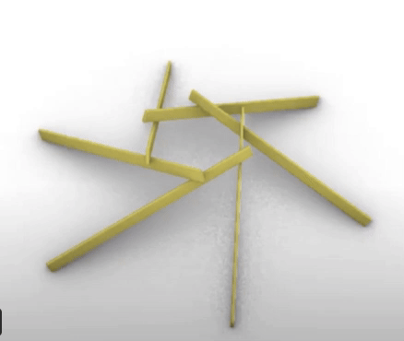
Digital Modelling
Parametric Modelling of Reciprocal Structures
Notes:
We also explored a generalized approach for parametric modeling of reciprocal structures. First, we fix the nodes or sides of a polygon, then extend these sides to create the structural members that form the reciprocal system.

Slide 4
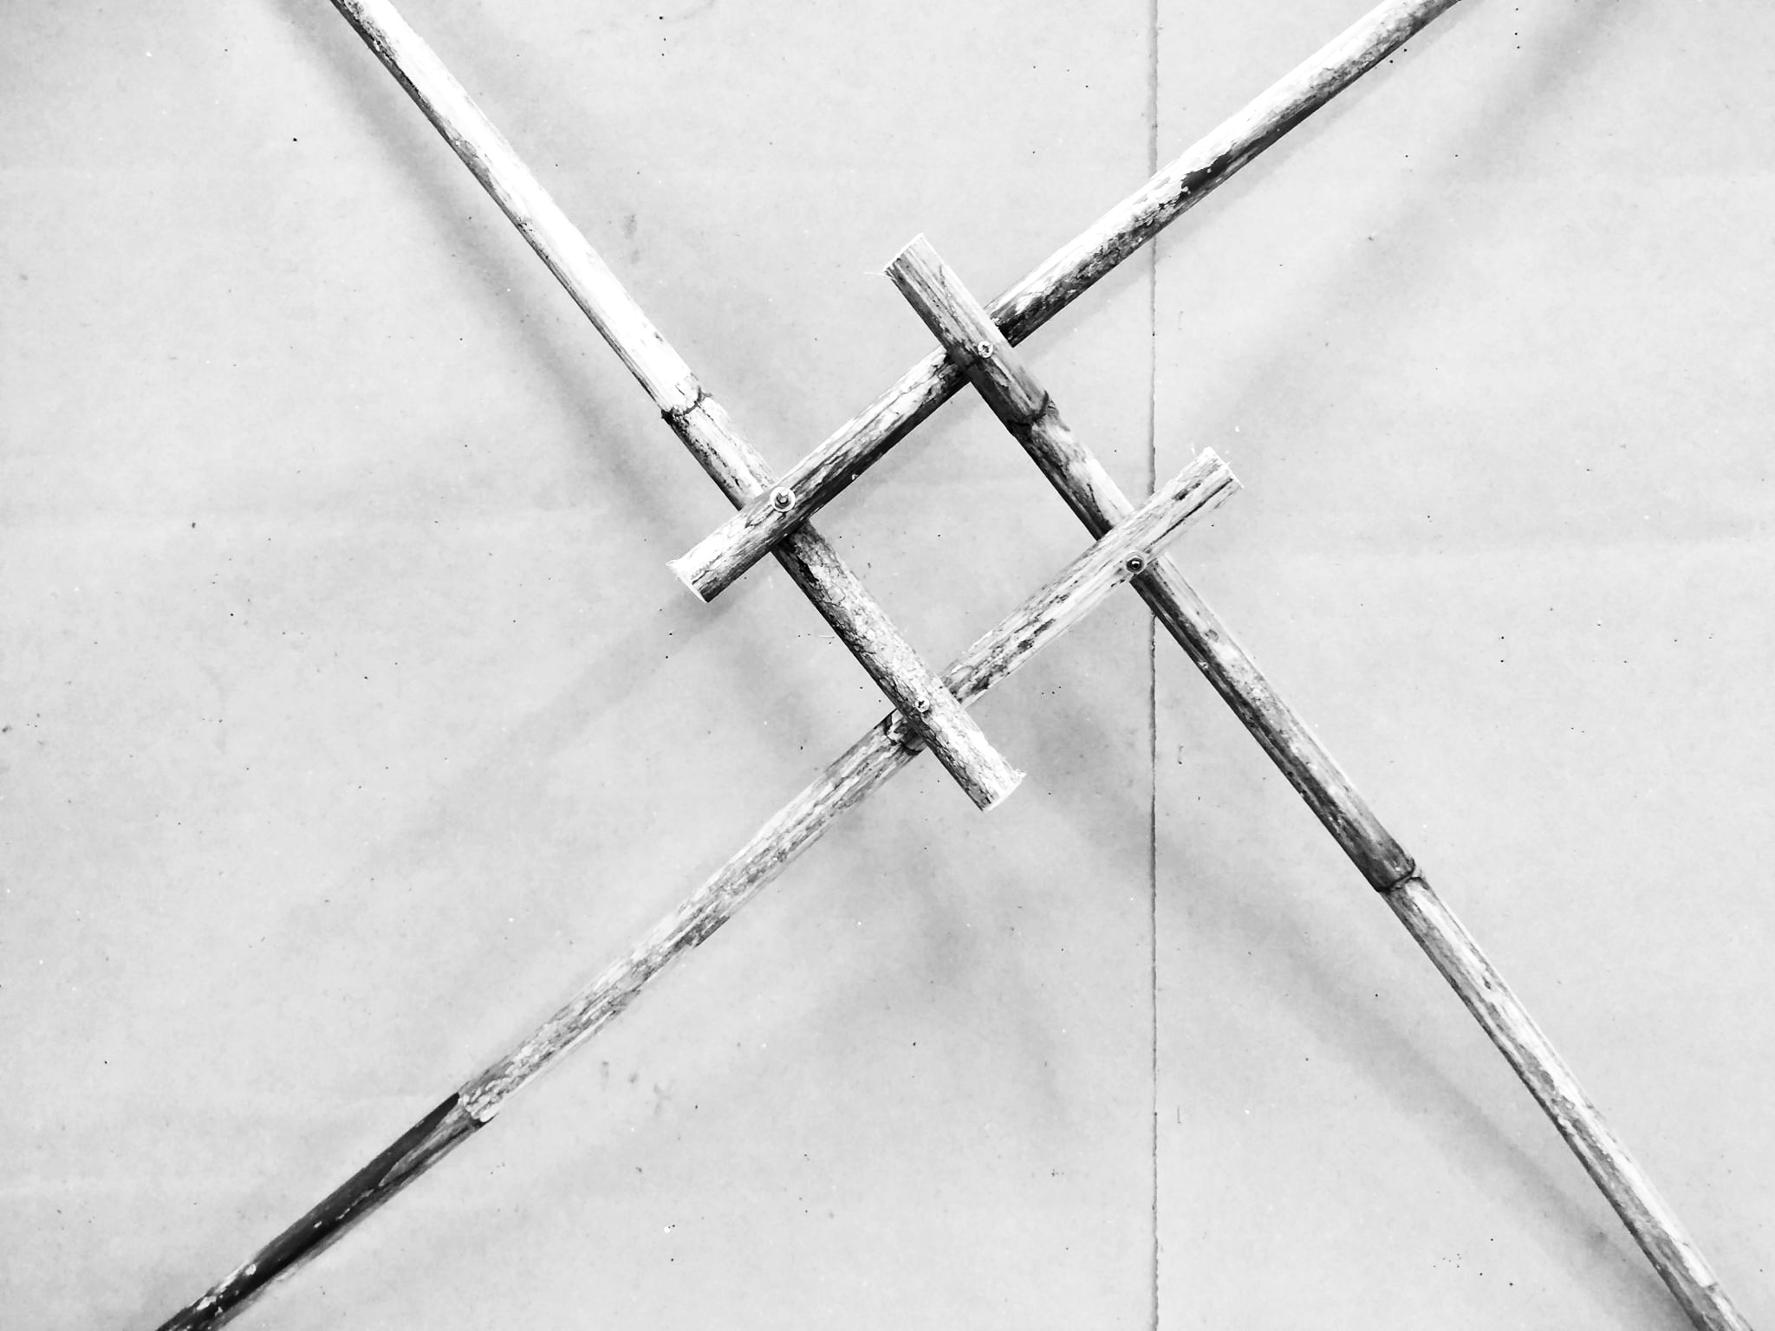
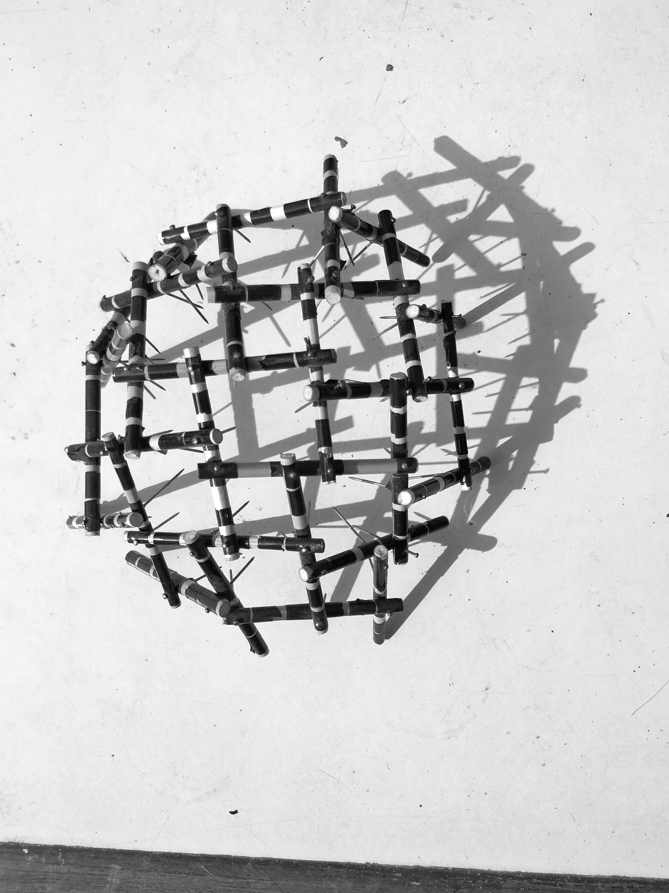
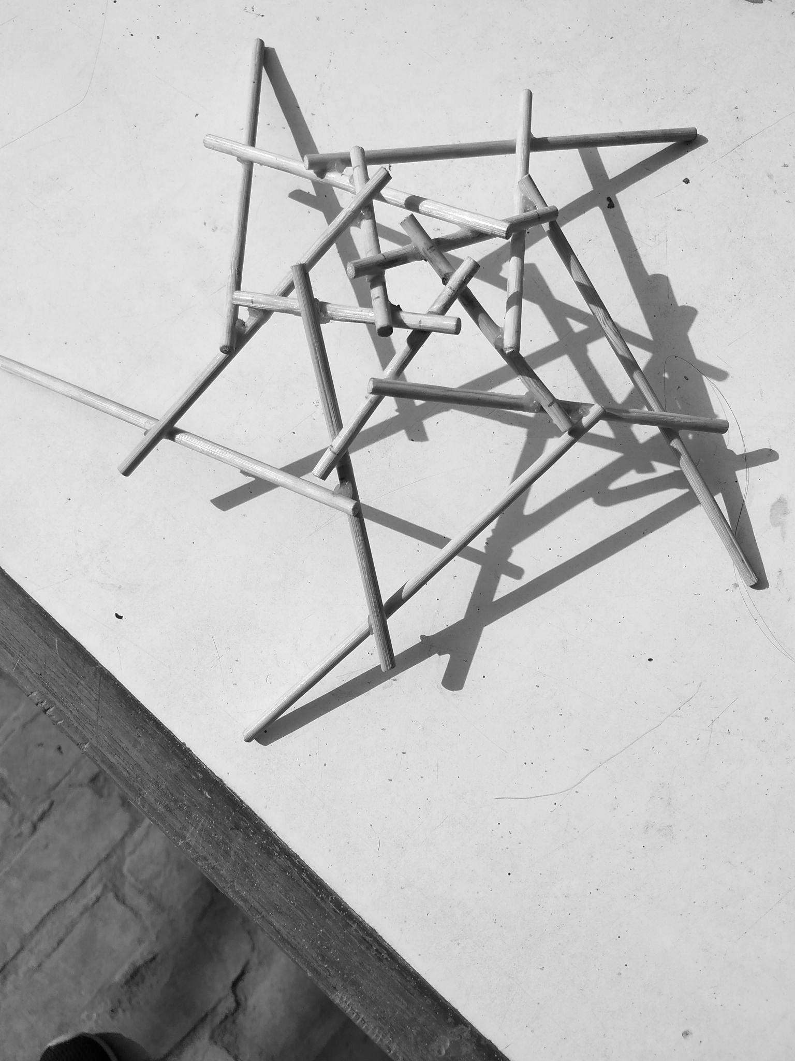
On-Site Fabrication
Physical Modelling of Reciprocal Structures
Notes:
On-site, joint locations on each member are carefully marked, as these measurements are crucial for the structural integrity and form of the assembly

Slide 5
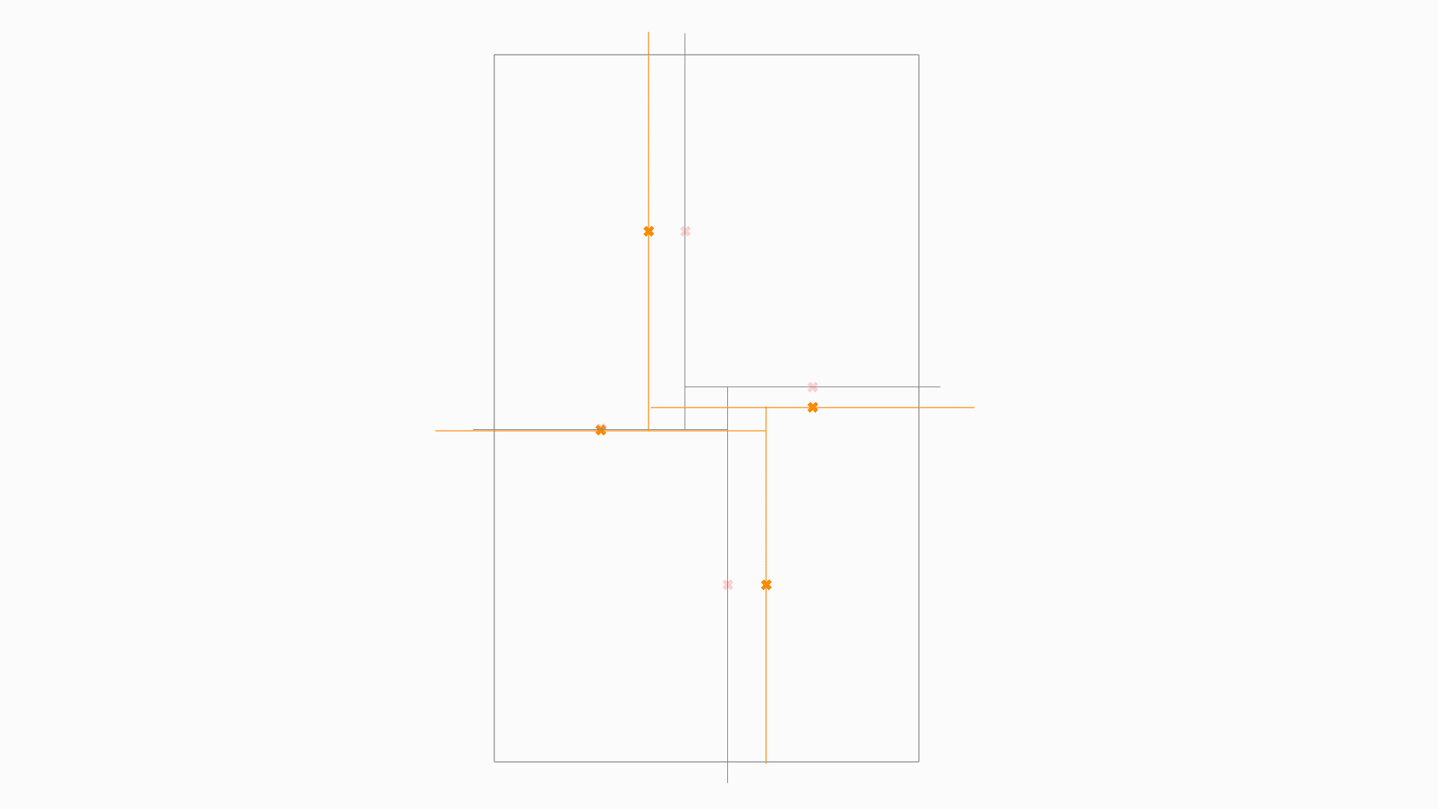
Initial trial
Start from basic layout
Update member lengths from stock
Adjust layout to member lengths
Notes:
For our initial trial of the agent-based system for designing reciprocal structures, we began with a basic reciprocal layout. Then, we adjusted member lengths according to available stock and adapted the layout to fit these updated lengths.

Slide 6
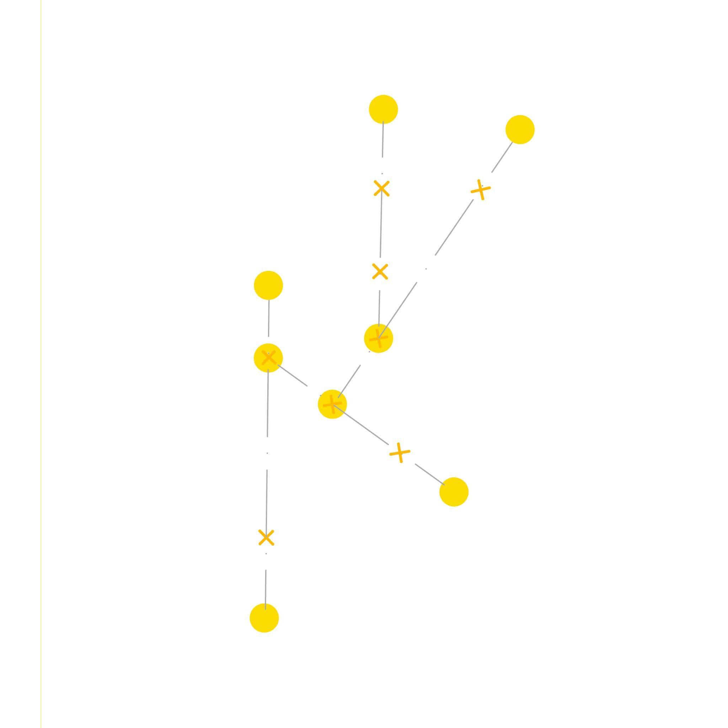
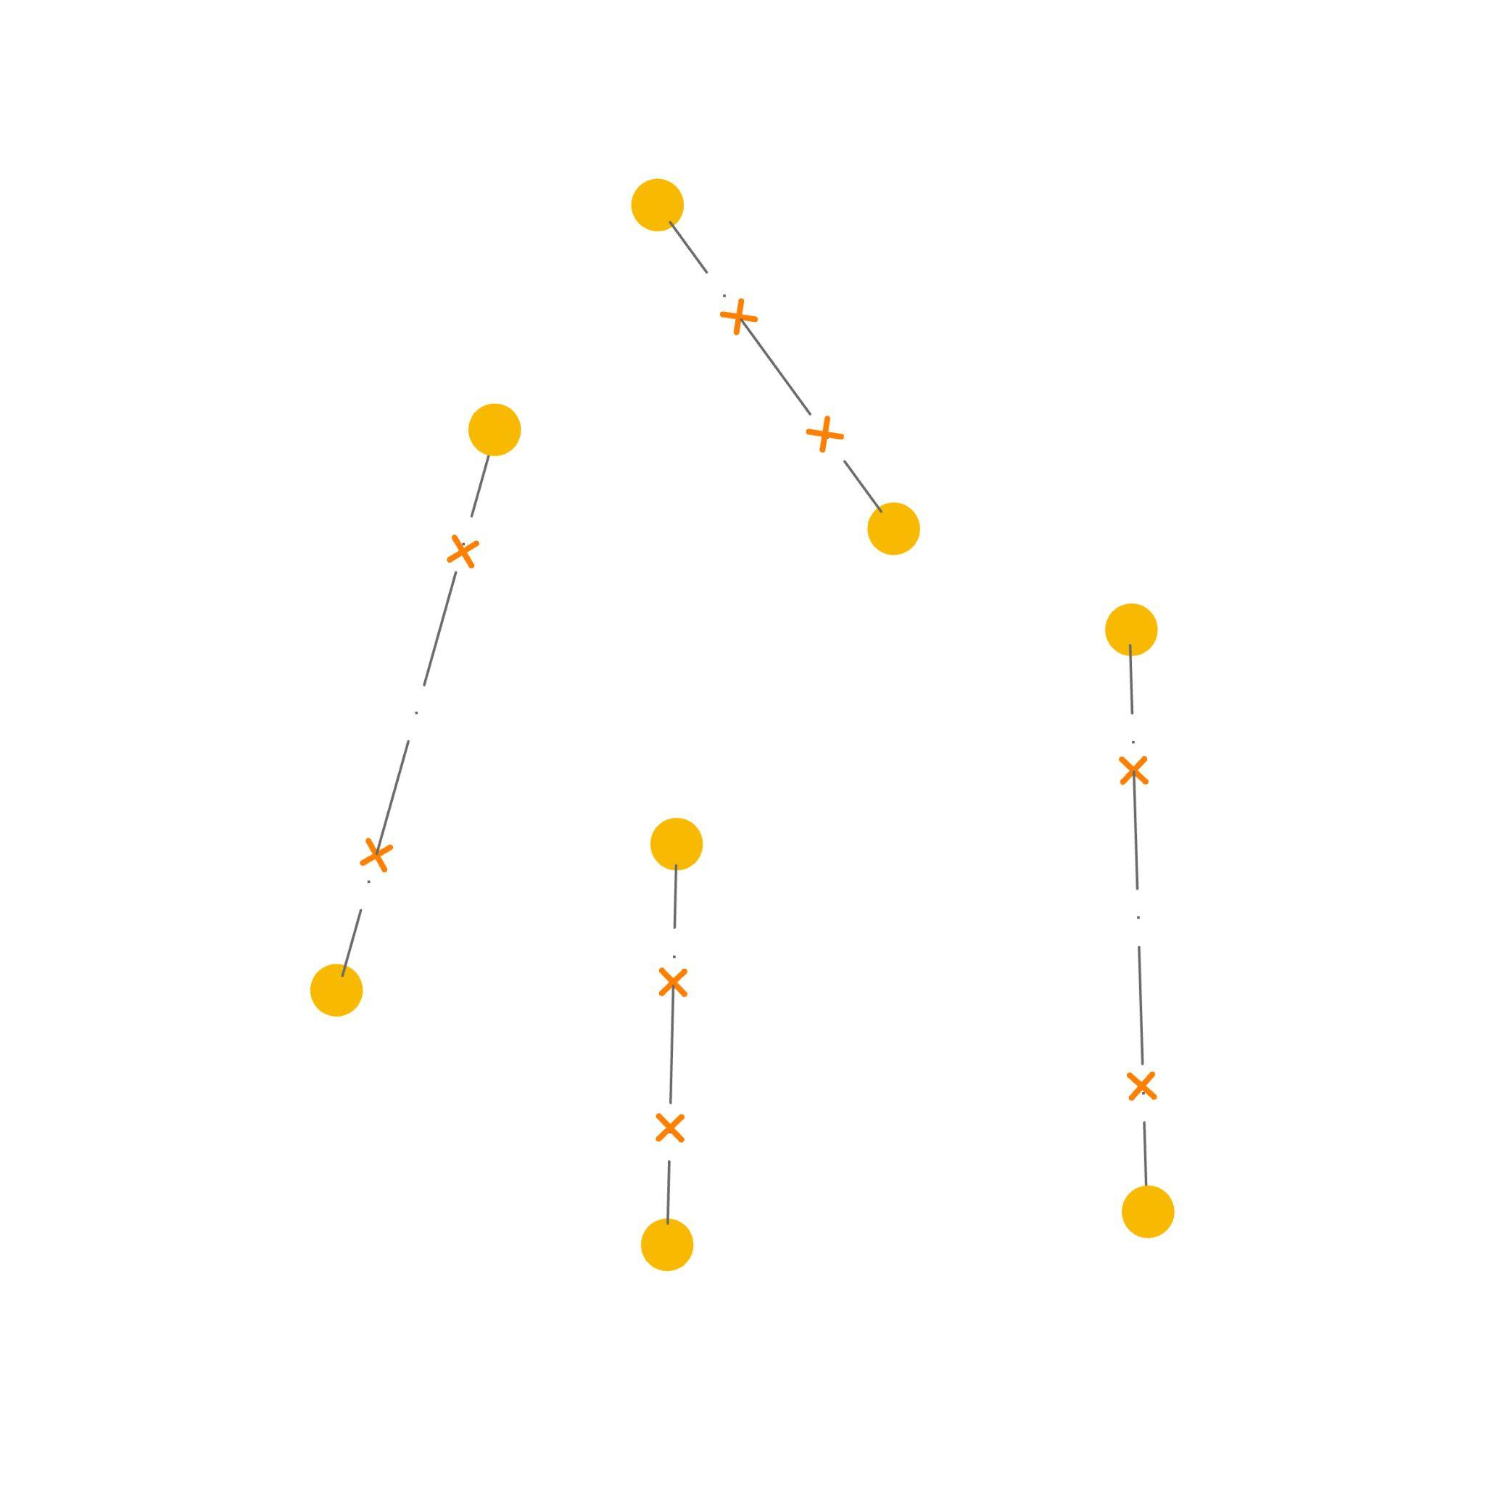
Agent System
3B
2B
1
0A
0
3A
1A
3
2
2A
0
1
2
3
1B
0B
Notes:
In our final agent system, we began with the existing timber members from stock, placing them randomly in a Cartesian coordinate system as their starting positions. We then allowed these members to form nodes based on specific behaviors we programmed.
Initially, we used boids system for this, but we quickly realized that working with the precise coordinates of the members in all behaviors was challenging.

Slide 7
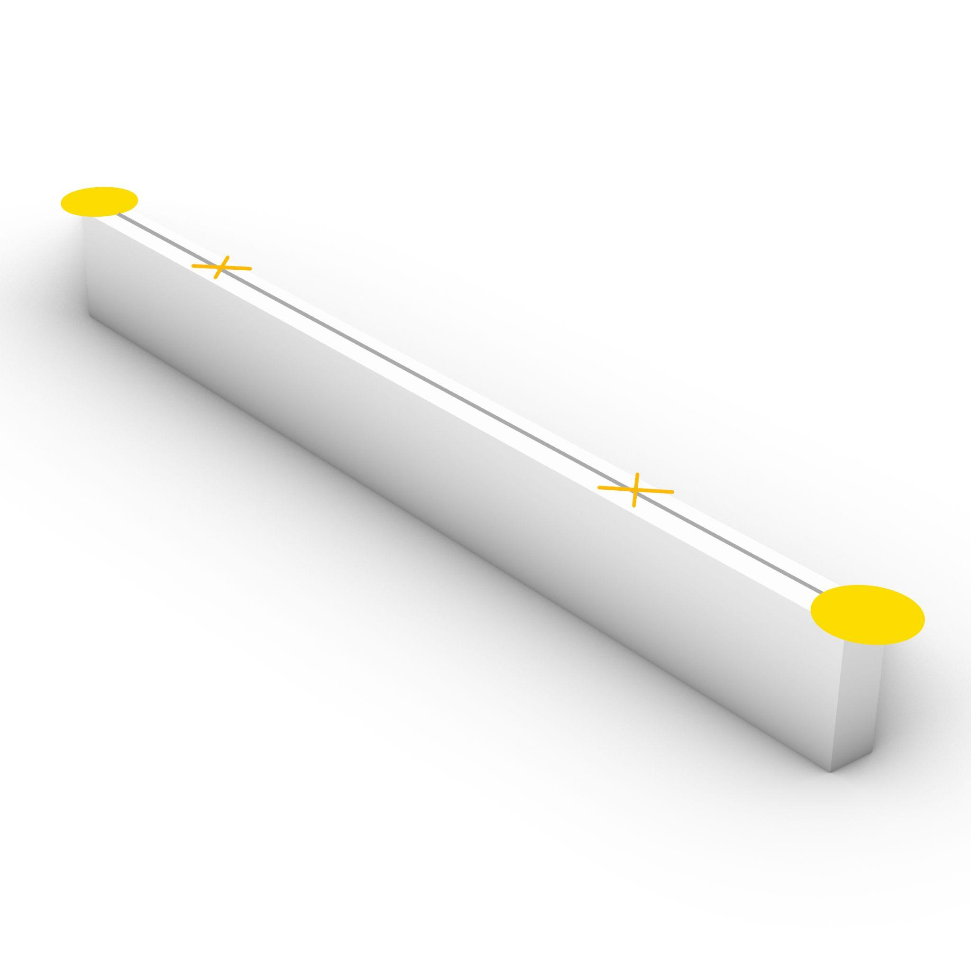
Agent
1B
Docking positions
1A
Agent Name: 1A
Partner Name: 1B
Member Distance: 1.2
Engagement Distance: 0.1
Docking: “empty”
Agent 1
Notes:
Each timber member from the stock is paired with two agents: for instance, Member 1 has agents 1A and 1B. These agents have defined parameters, such as a length of 1.2 meters, an engagement distance of 0.1 meters, and a status indicating whether the member is docked. All of this information is embedded as custom data for each agent.
The engagement distance serves as the docking point for connecting with other members.

Slide 8
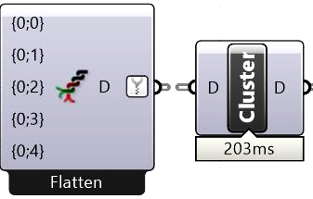
Custom Data
Agent Name
Name
0A
Name
1A
Name
2A
Name
3A
Partner Name
Agent 0
Name
0B
AgentName
0A
Name
1B
PartnerName
0B
Name
2B
Distance
1
Name
3B
e
0.1
docking
“empty”
Distance
Dist
1
Agent 1
Dist
1.2
AgentName
1A
Dist
1.5
PartnerName
1B
Dist
1
Distance
1.2
Engagement Dist
e
0.1
e
0.1
docking
“empty”
e
0.1
e
0.1
e
0.1
Docking Agent
Name
“empty”
Name
“empty”
Name
“empty”
Name
“empty”
Notes:
This is how the custom data is structured: we pass lists containing Agent names, Partner names, Member lengths, Engagement distances, and docking Agents, all of which are organized into individual agent data in the form of a dictionary.

Slide 9
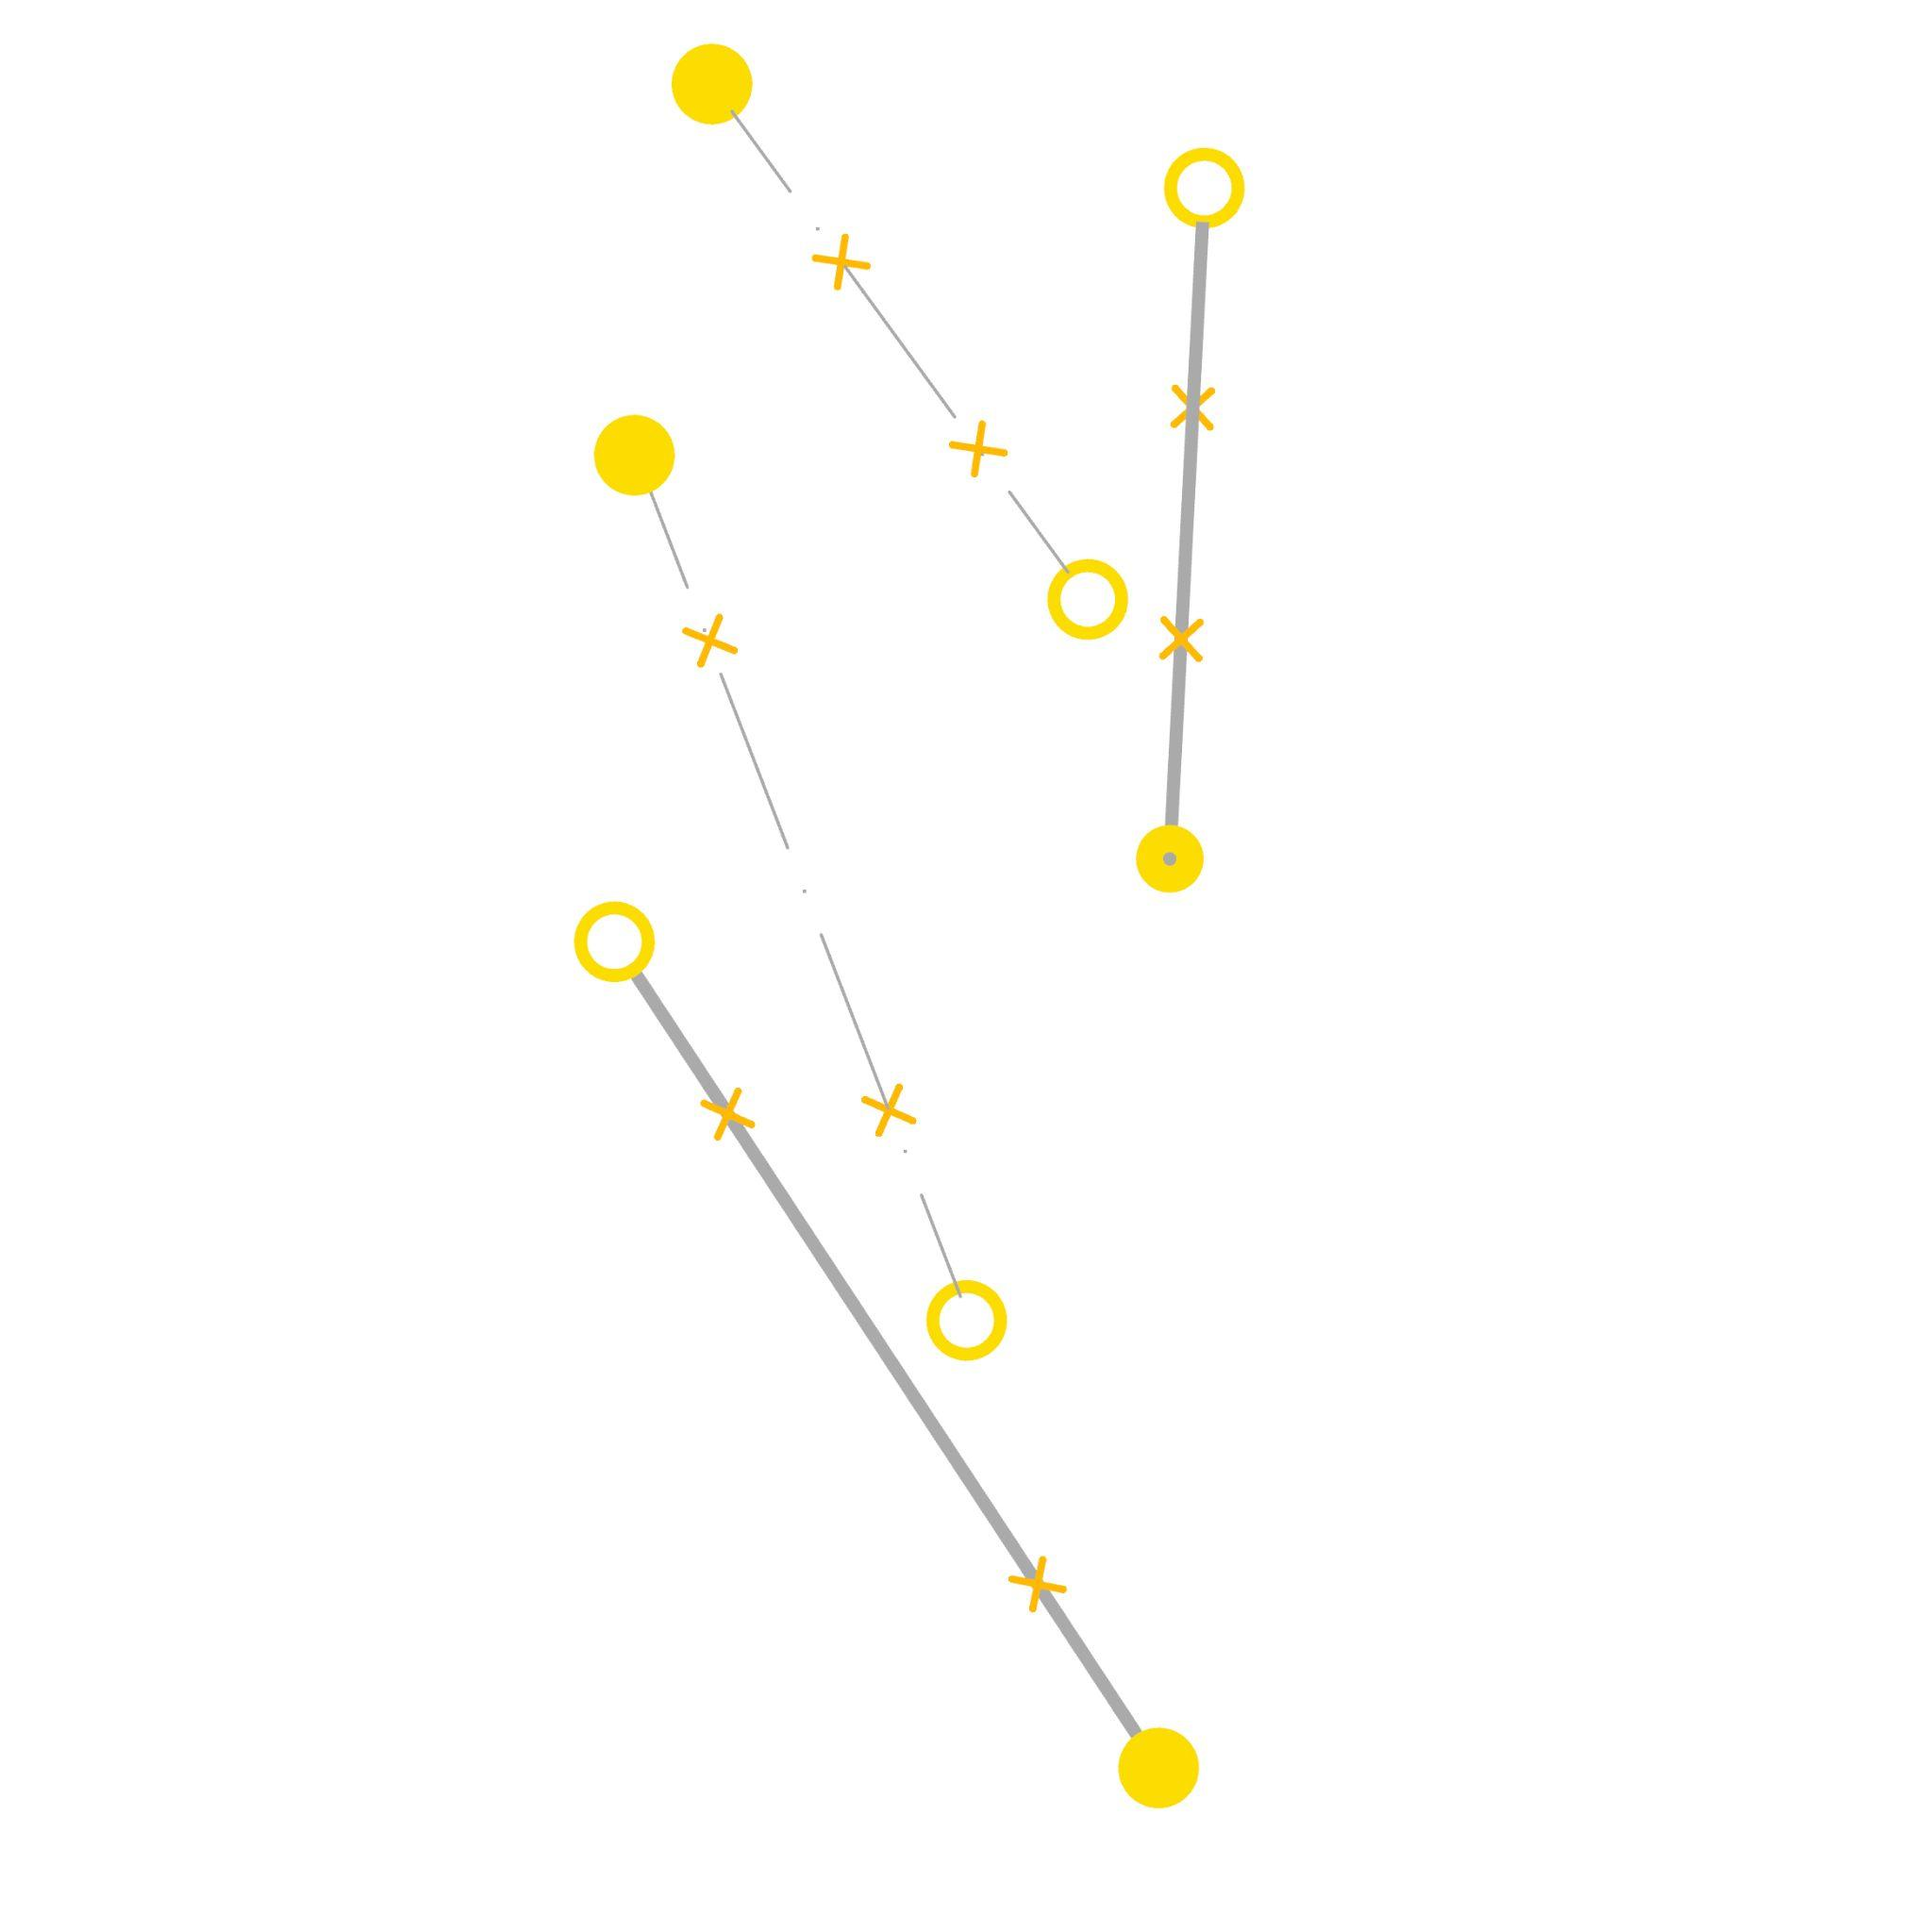
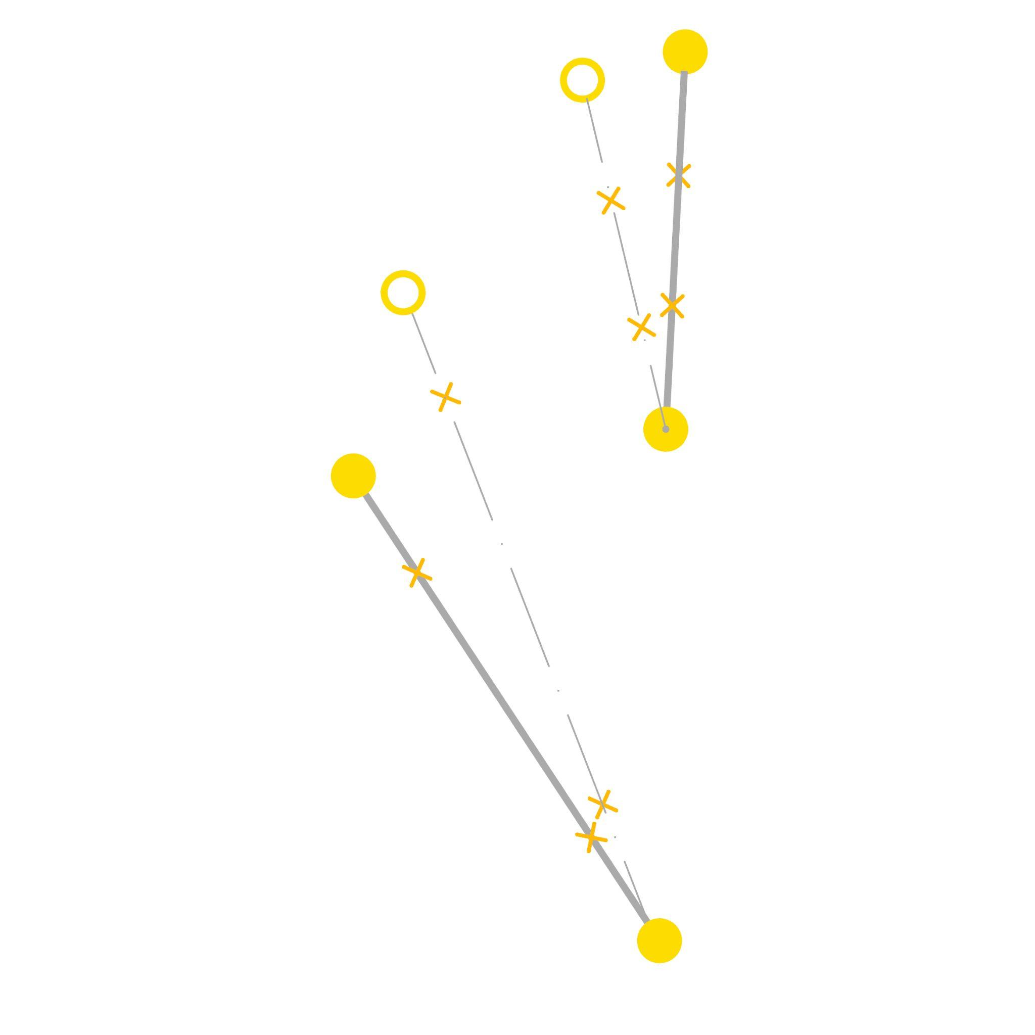
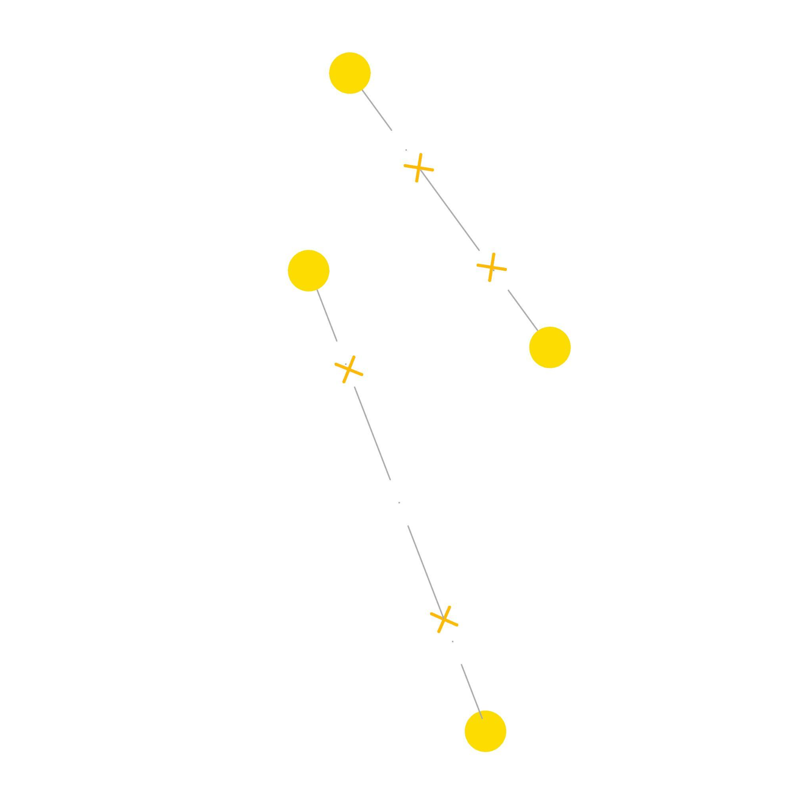
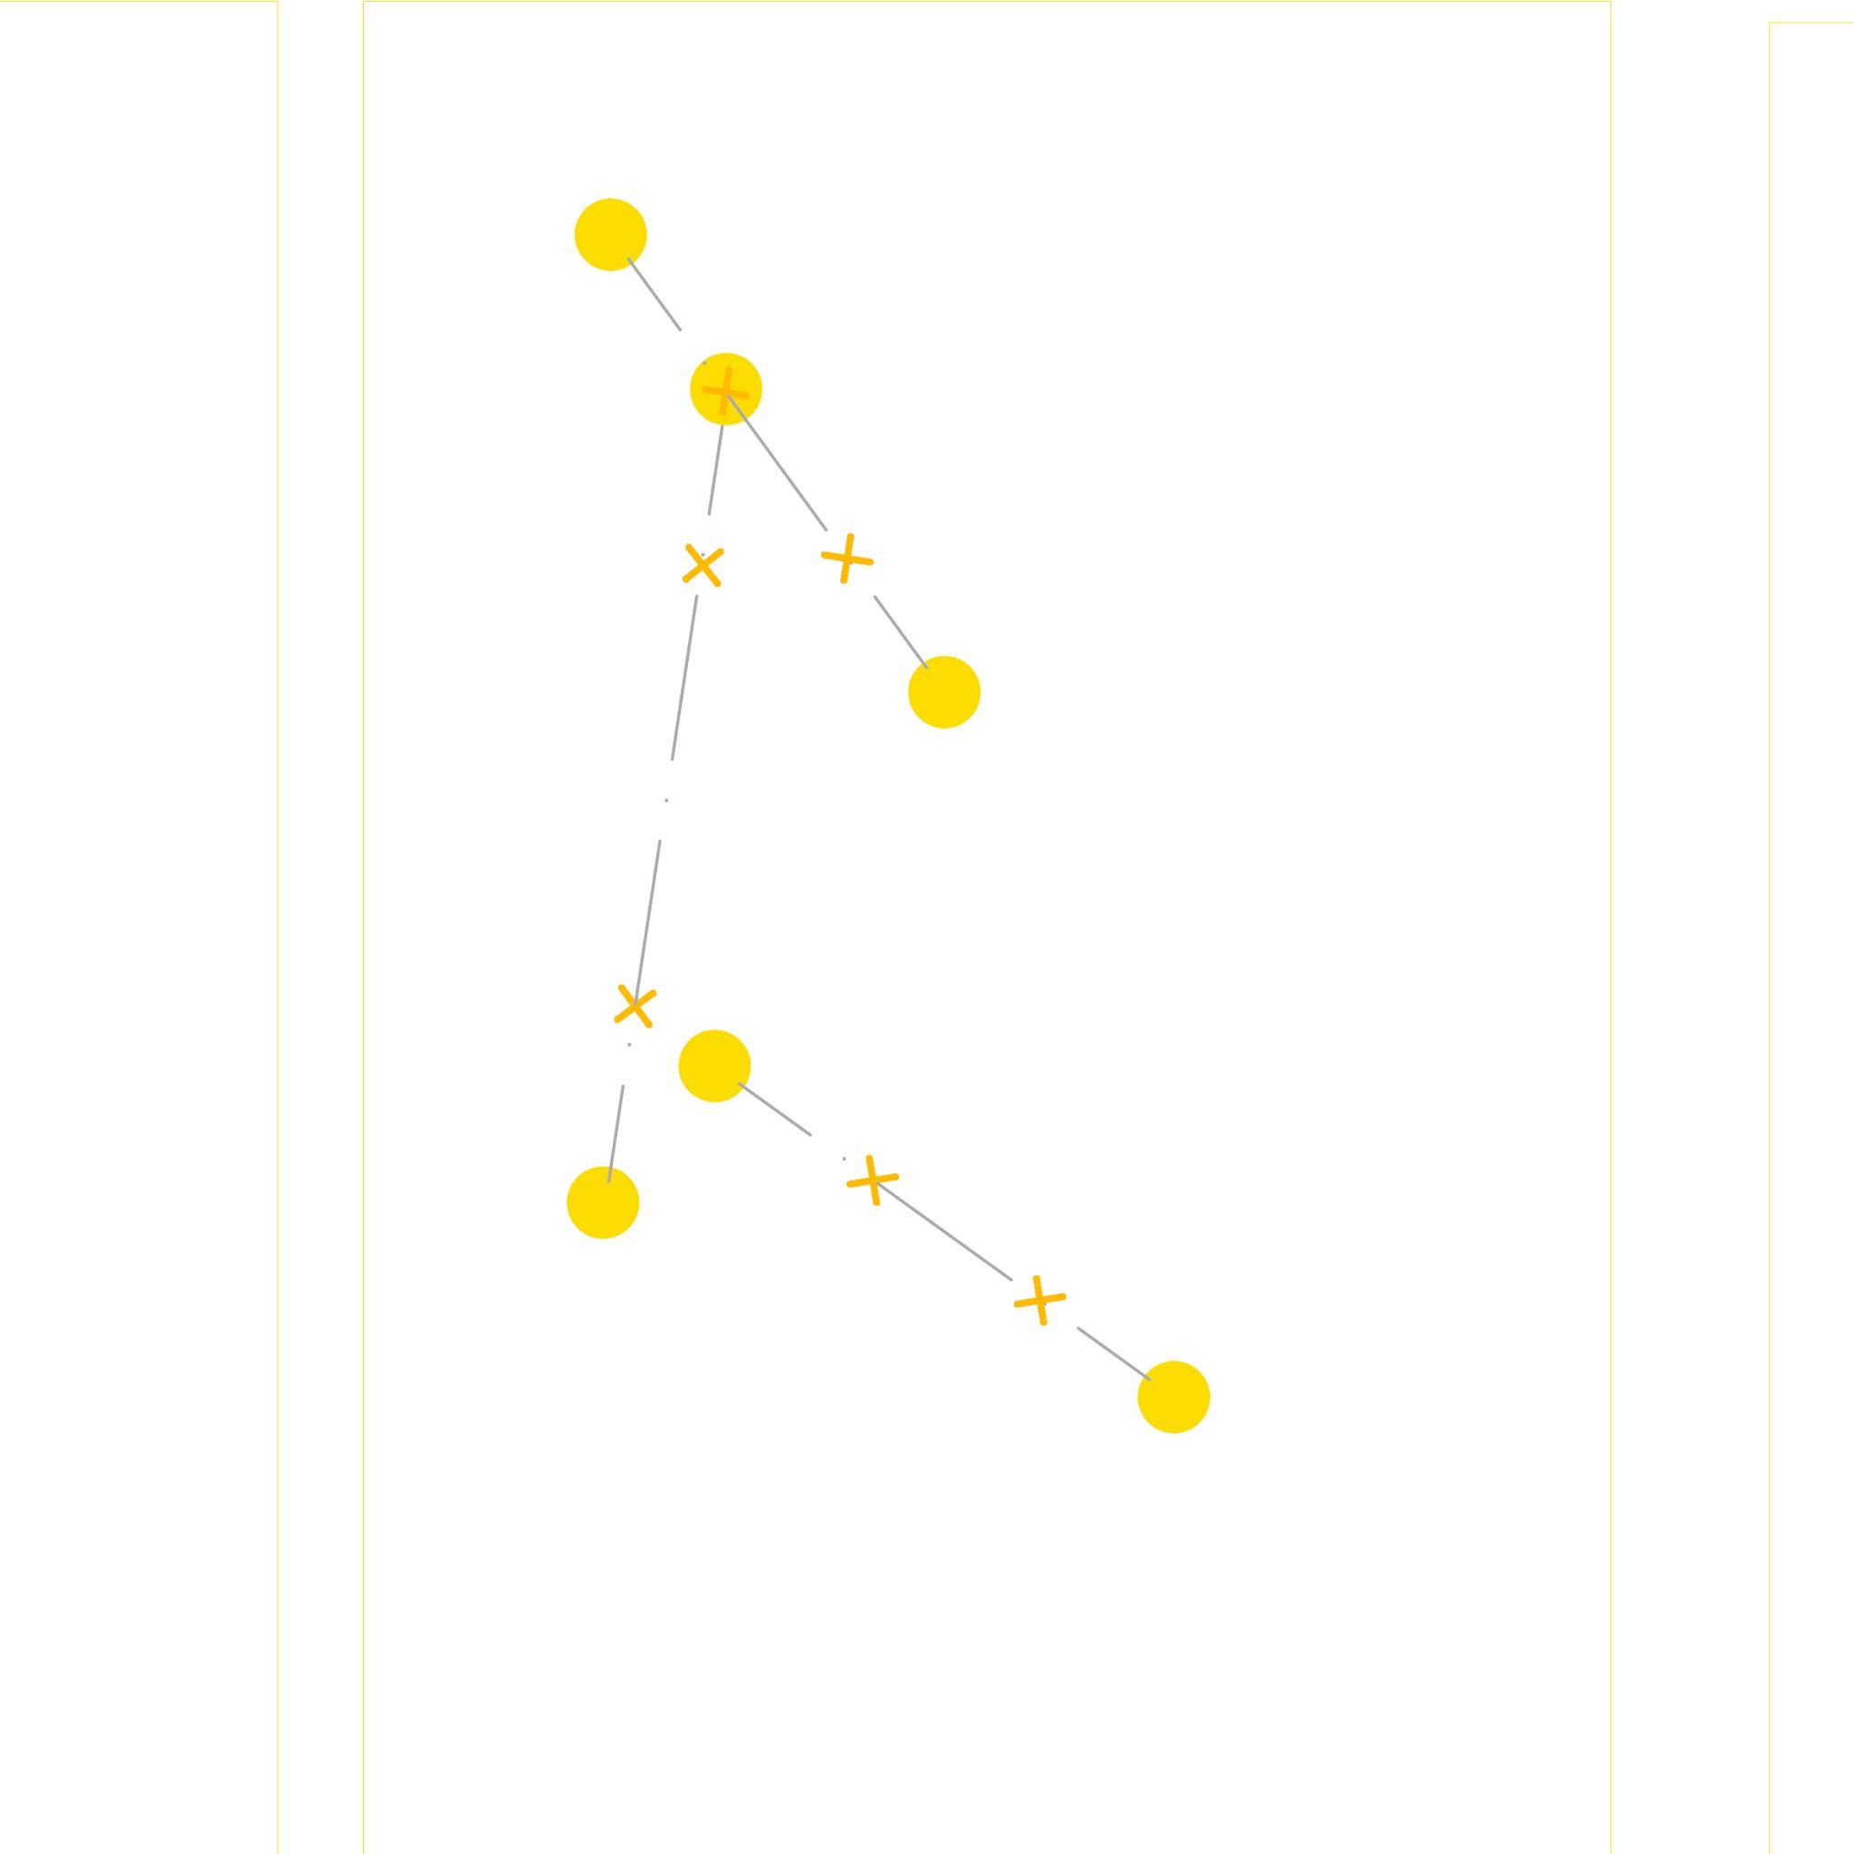
Behaviors
1B
1B
0A
0A
0A
0A
0A
1A
1A
0A
2A
0B
0B
2B
0B
0B
0B
Wander
Partner Cohesion
Attraction
Docking
Notes:
The agents exhibit four behaviors: wandering, partner cohesion, attraction, and docking.
The wandering behavior allows the agent to guide the timber member as it moves through space, continuously updating its location.
Partner cohesion ensures that the partner agent moves alongside the original agent in the same direction, maintaining a constant member distance.
The attraction behavior causes the agents to draw closer to one another, facilitating docking and the formation of nodes.
Finally, the docking behavior enables members to dock with each other, updating the names of the docked members so no other member can dock with them again, allowing all members to form stable nodes.

Slide 10
Agent System
Custom Data:
Name
Partner
Distance
E distance
Docking
Solver
Cartesian Agent
Cartesian Agent System
Behaviors:
Wander
Partner Cohesion
Attraction
Docking
Notes:
Therefore, our agent system consists of Agent data and all behaviors, each with the same weight, as input to the Cartesian agent. This input forms the Cartesian agent system, which is then solved to run the simulations.

Slide 11
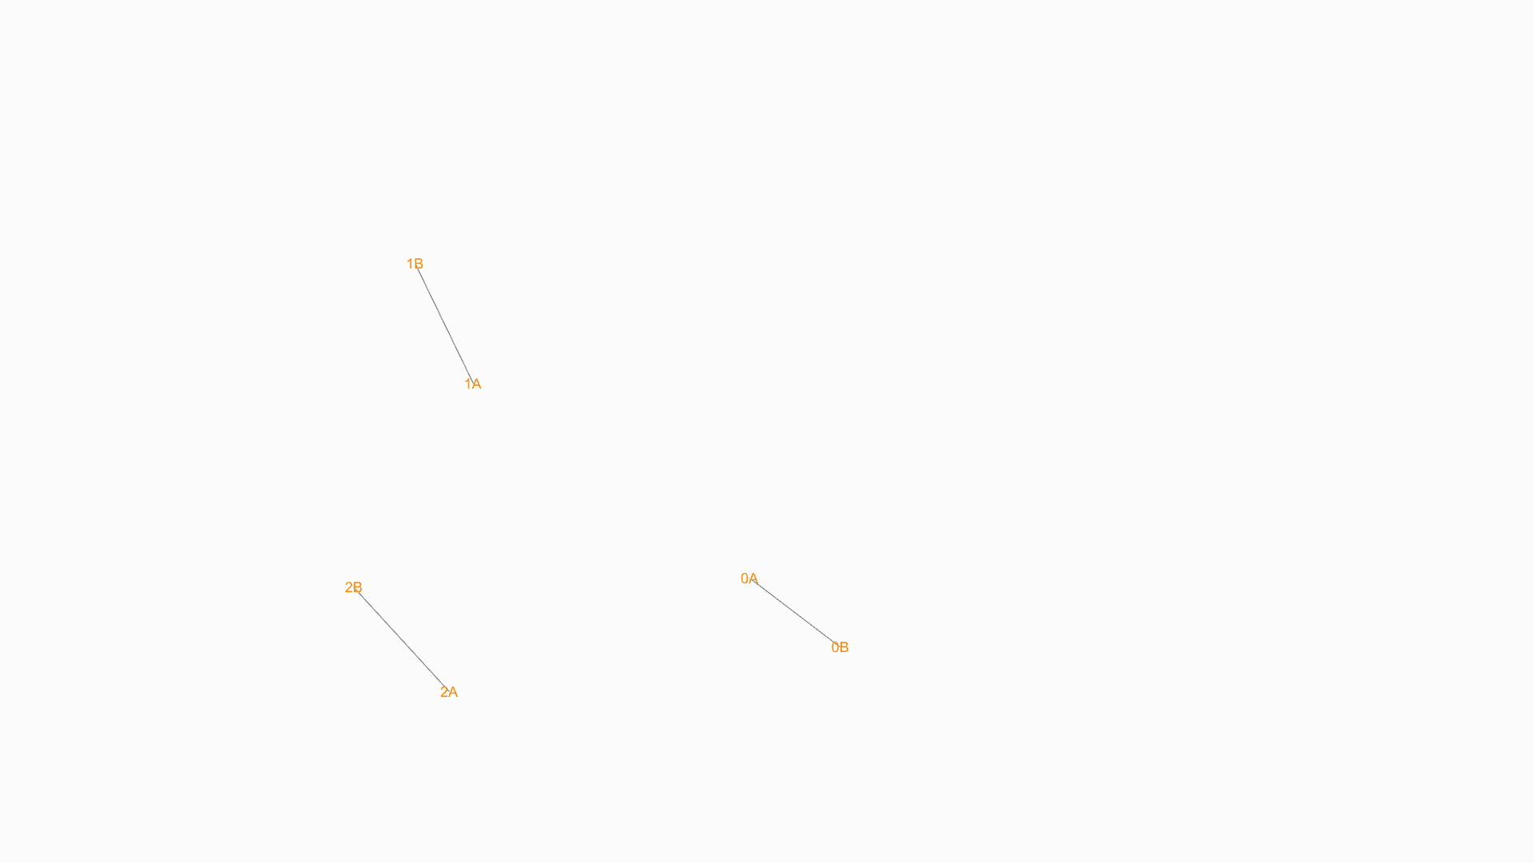
Node Formation
Elements: 3
Element lengths: 1.0 -1.5
Engagement distance: 0.7
Notes:
Nodes formed with any set of members, different geometries possible. With three members it forms a triangular node

Slide 12
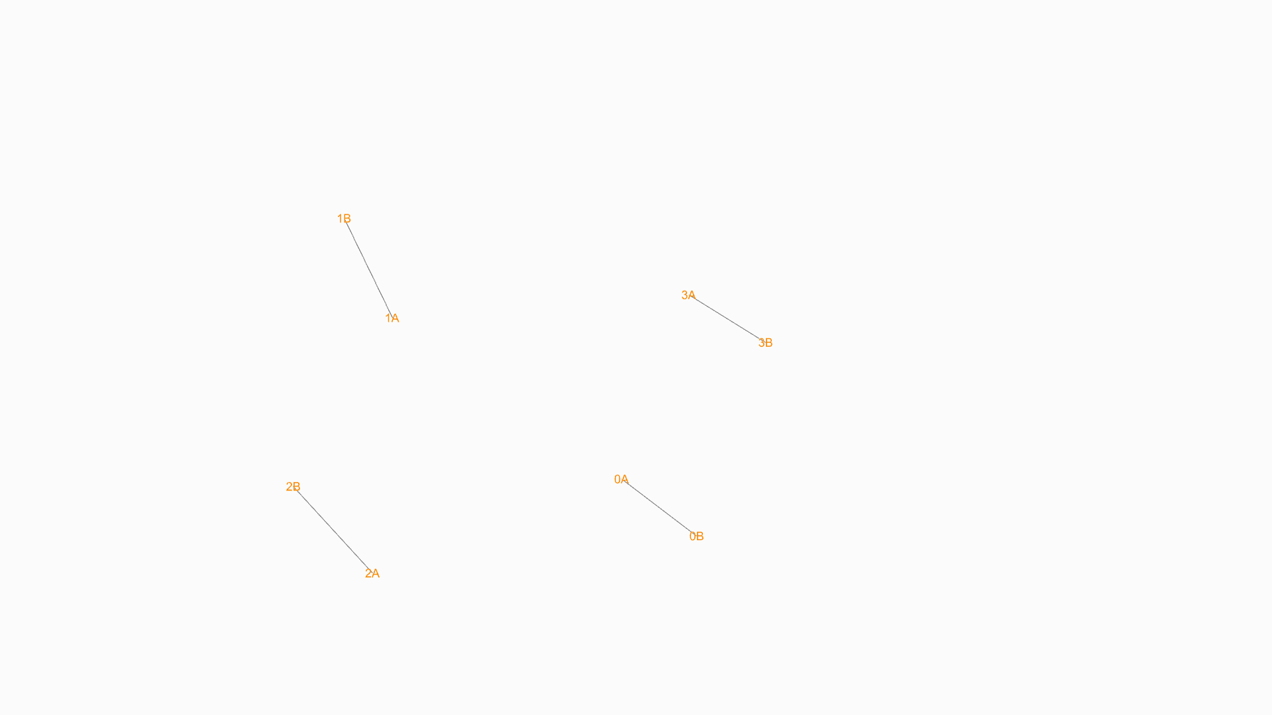
Node Formation
Elements: 4
Element lengths: 1.0 - 1.5
Engagement distance: 0.7
Notes:
Whereas with 4 members it forms a quadilateral node.

Slide 13
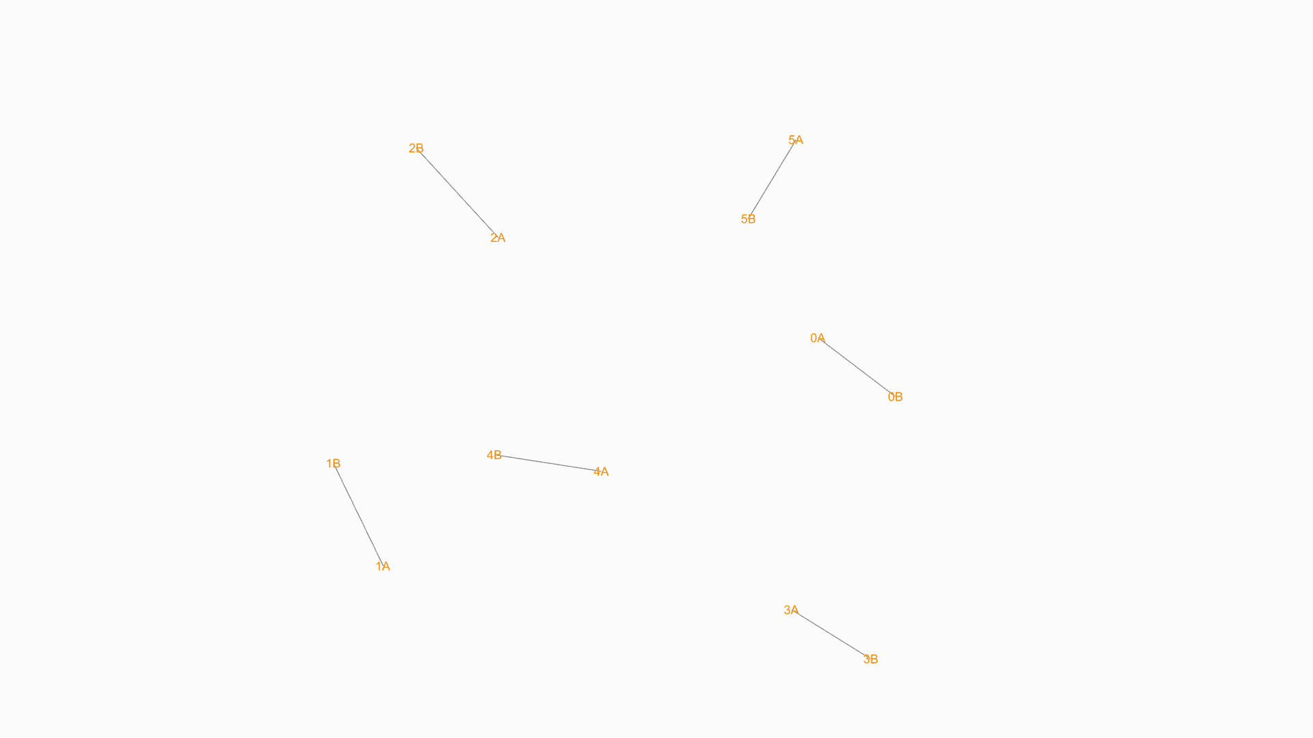
Clustering
Elements: 6
Element lengths: 1.0-1.5
Engagement distance: 0.7
=> 2 3-element-clusters
Notes:
With 6 members, two triangular nodes

Slide 14
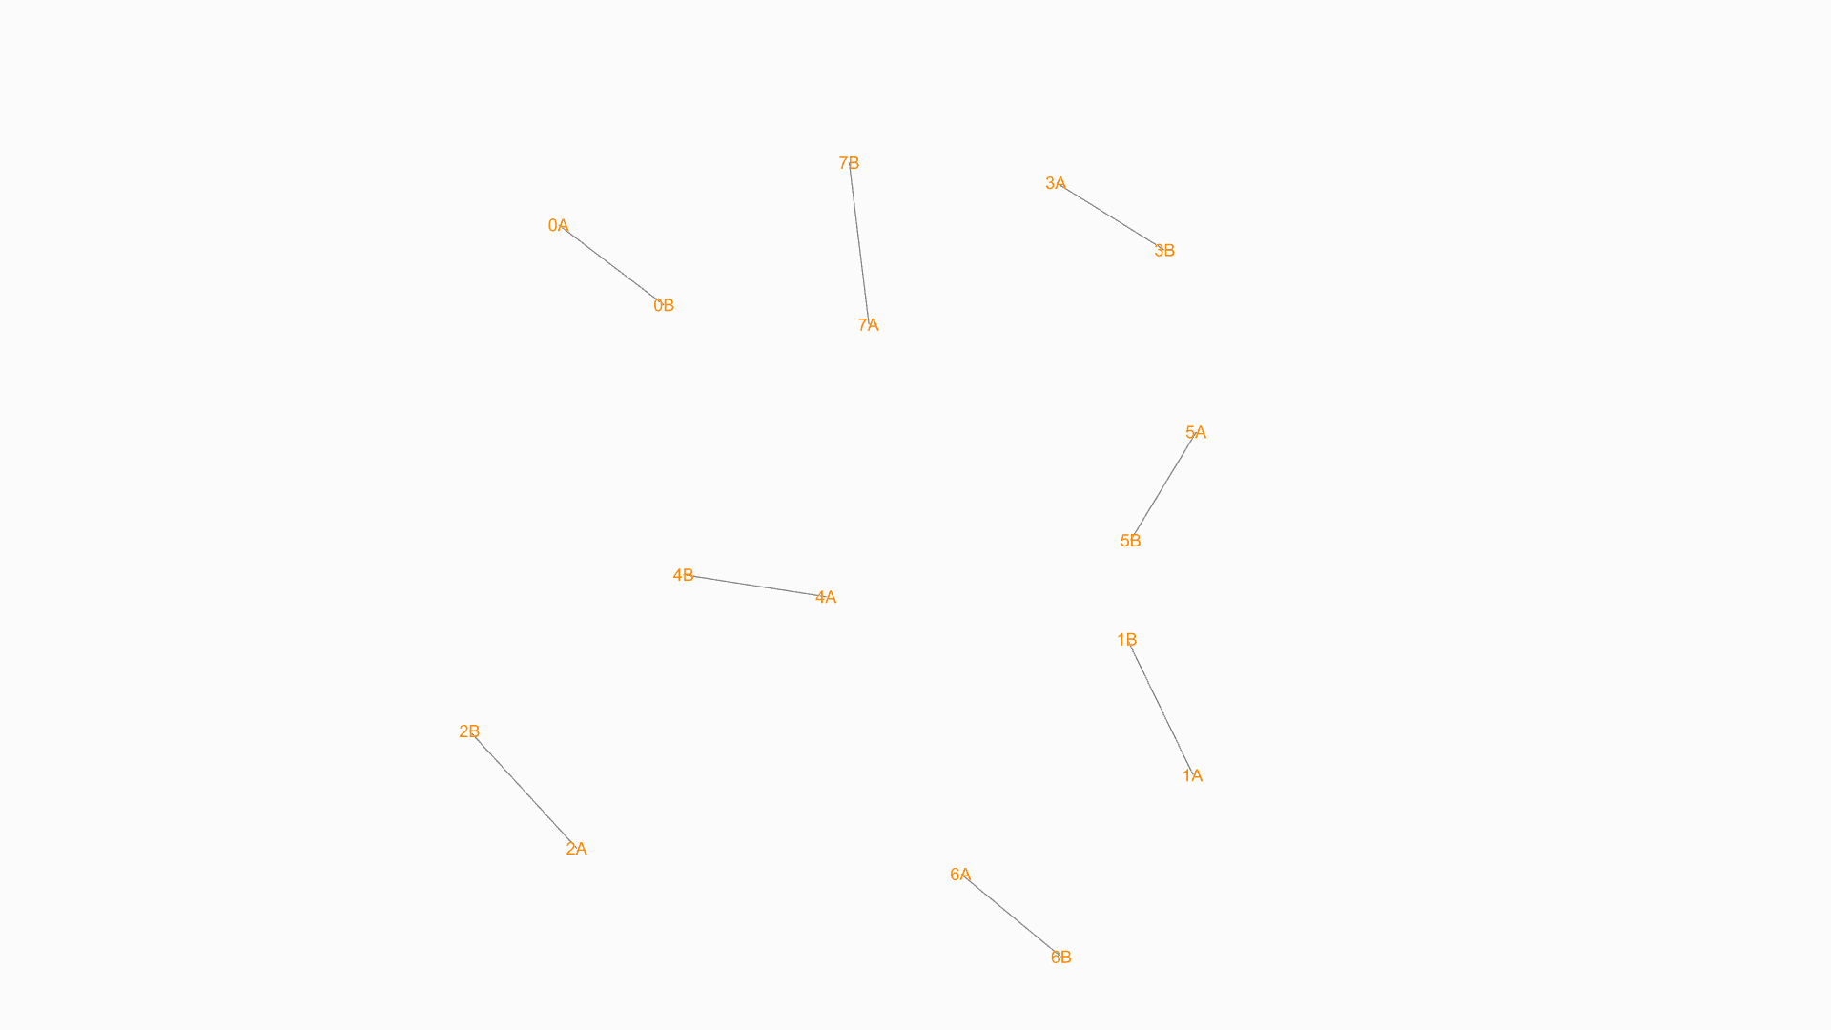
Clustering
Elements: 8
Element lengths: 1.0-1.5
Engagement distance: 0.7
=> 2 4-element-clusters
Notes:
With 8 members, we create 2 quadrilateral nodes. This demonstrates the flexibility of our system, as the nodes are formed based on the number of members available.

Slide 15
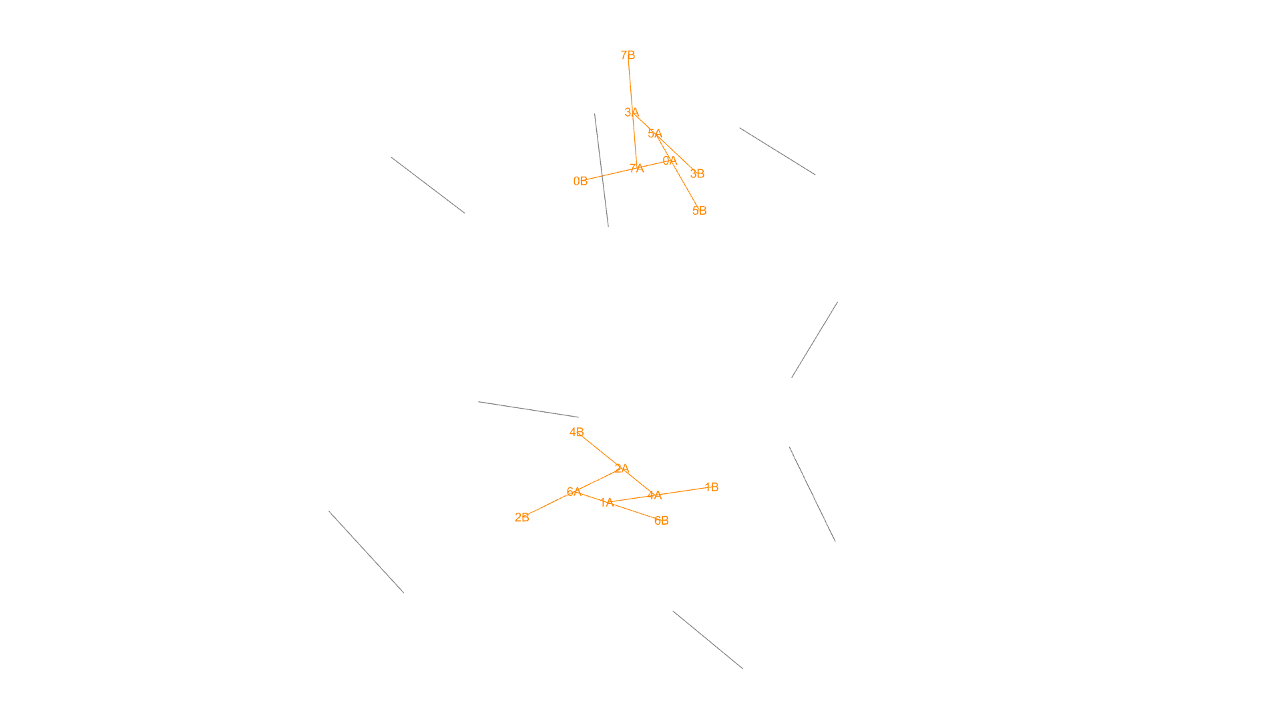
Discussion
Elements: 8
Element lengths: 1.0-1.5
Engagement distance: 0.7
Engagement distance should be adjustable to avoid large angles
Notes:
One observation from our system is that the engagement distance of the members should be adjustable to prevent large angles.

Slide 16
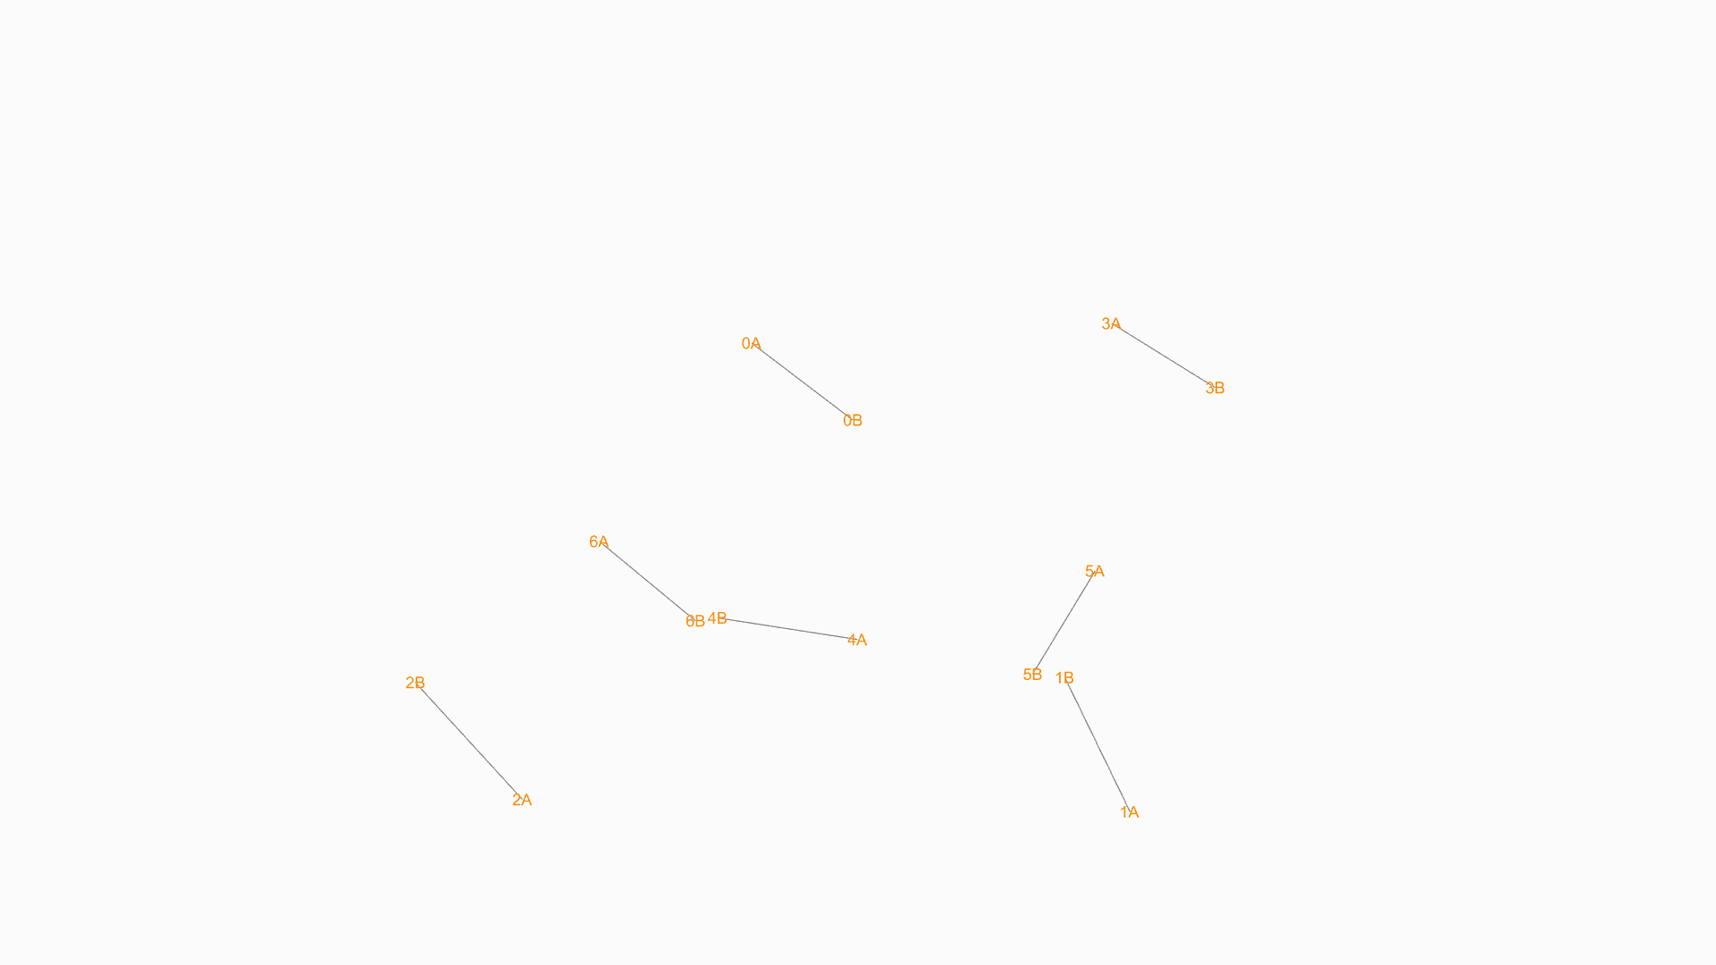
Discussion
Elements: 7
Element lengths: 1.0-1.5
Engagement distance: 0.7

Slide 17
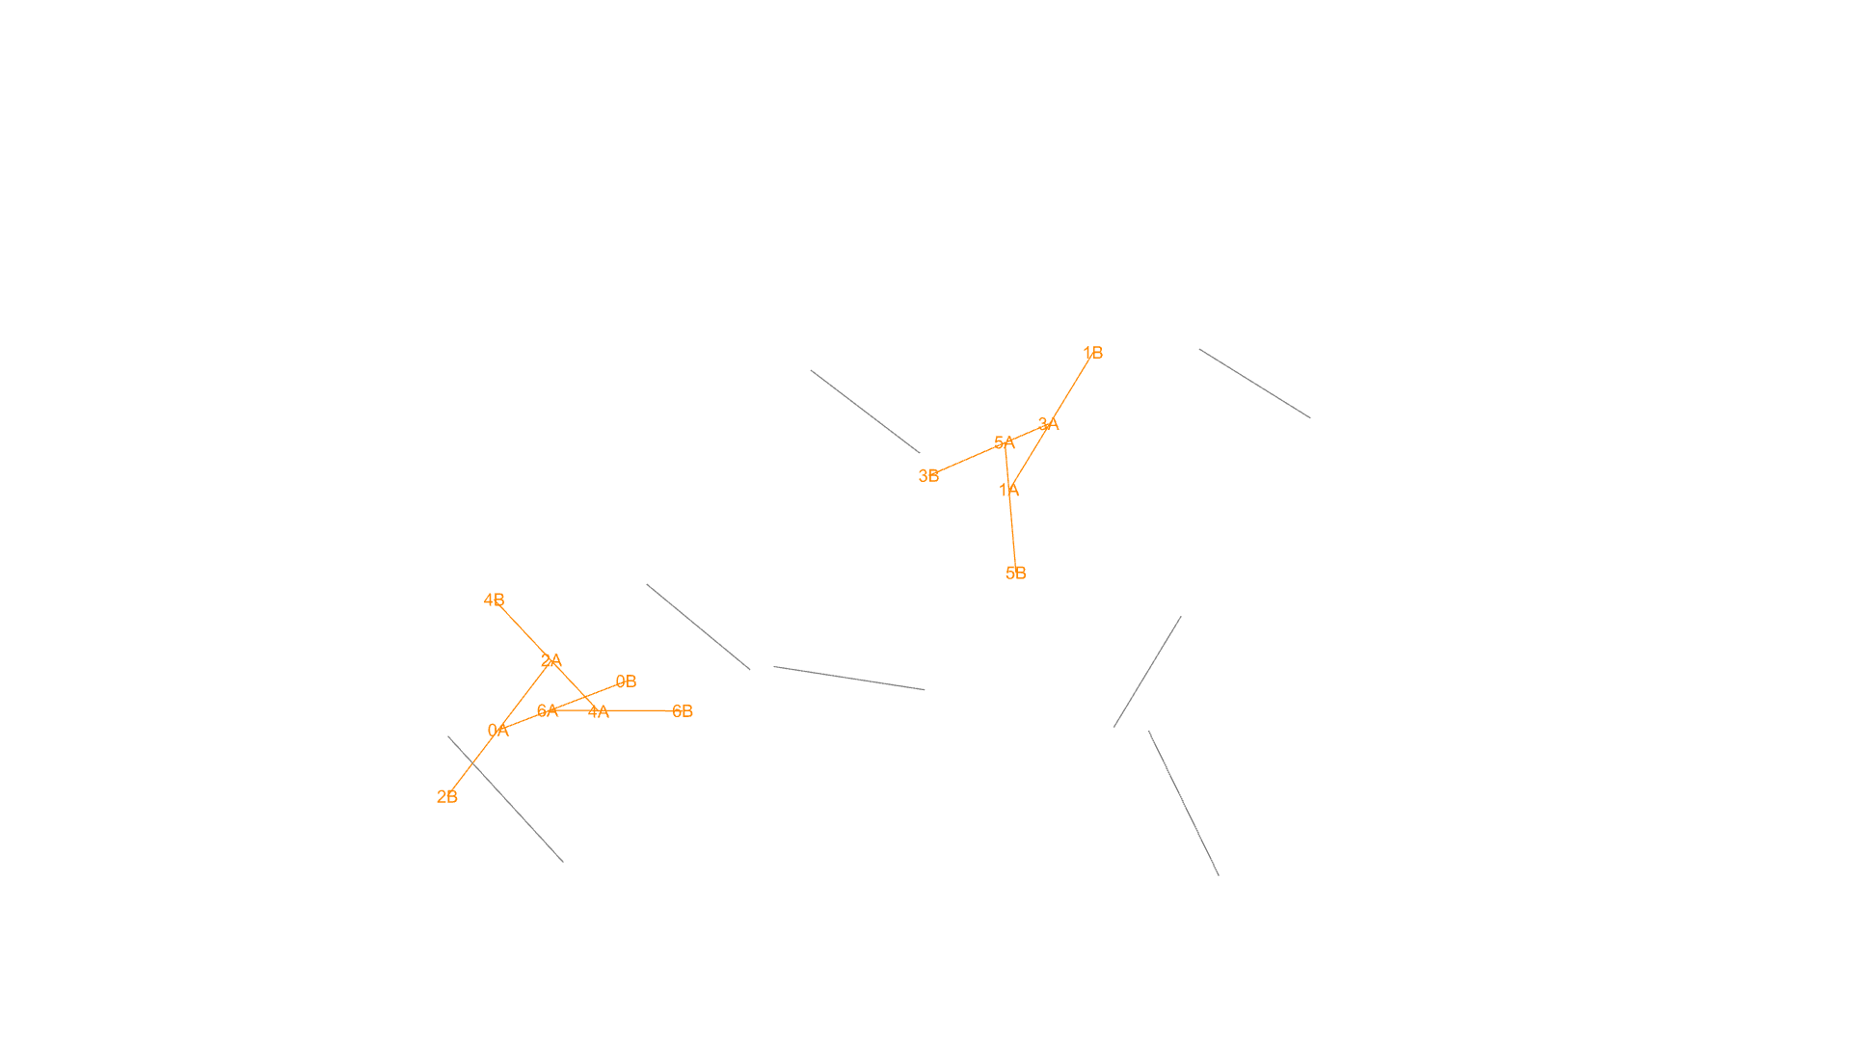
Discussion
Elements: 7
Element lengths: 1.0-1.5
Engagement distance: 0.7
0B should be on other side of 6A6B to ensure directionality of node
Notes:
And 0B should be on other side of 6A6B to ensure directionality of node

Slide 18
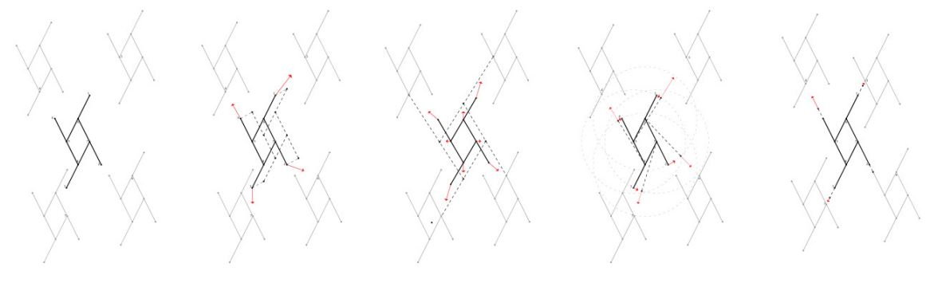
Outlook
Movement towards
neighbours
Orienting towards
neighbours
Stretching towards
neighbours
Scale Entity
Tamke, Martin, Jacob Riiber, Hauke Jungjohann, and Mette Ramsgard Thomsen. “Lamella Flock.” In Advances in Architectural Geometry 2010, edited by Cristiano Ceccato, Lars Hesselgren, Mark Pauly, Helmut Pottmann, and Johannes Wallner, 37–48. Vienna: Springer Vienna, 2010. https://doi.org/10.1007/978-3-7091-0309-8_3.
Notes:
For the next steps, we believe that once equilibrium is reached in the individual nodes, we can implement neighbor behaviors on the nodes, similar to those in lamella flocking, to generate larger geometries.

Slide 19
Outlook
Parametric Modelling of Reciprocal Structures
Lamella Flock by
Martin Tamke Cita & Royal Danish Academy
(2010)
Notes:
The advantage of our system lies in the fact that, due to the behaviors involved in node formation, our nodes are highly flexible in terms of geometry and the available timber stock. As a result, even larger geometries formed are both intriguing and exploratory, allowing for the creation of custom nodes.

Slide 20
Outlook
Current Implementation
Improved Implementation
Point based cartesian agents with custom data for:
Name
Name of Partner agent
Distance
Engagement distance
Name of Docking position
Agent pairs have redundant information for partner and distance
Inefficient search for partner agent and docking position with for loop over all agents
Element agents with members for:
Endpoints
Anchor Points
Distance
Engagement distance
Connected Elements
Cluster Elements
No agent pairs with redundant information
Direct access of endpoints and anchor points
Direct reference to connected elements
Direct reference to other elements in cluster
vs
Notes:
Some potential improvements to our current implementation include addressing the redundancy of partner and distance information in agent pairs. Additionally, the search for partner agents and docking positions is inefficient due to the use of a for loop over all agents. We could eliminate redundant agent pair information, enabling direct access to endpoints and anchor points, as well as direct references to connected elements and other elements within the cluster.

Slide 21
References
Tamke, Martin, Jacob Riiber, Hauke Jungjohann, and Mette Ramsgard Thomsen. “Lamella Flock.” In Advances in Architectural Geometry 2010, edited by Cristiano Ceccato, Lars Hesselgren, Mark Pauly, Helmut Pottmann, and Johannes Wallner, 37–48. Vienna: Springer Vienna, 2010. https://doi.org/10.1007/978-3-7091-0309-8_3.
Parigi, Dario. “Minimal-Waste Design of Timber Layouts from Non-Standard Reclaimed Elements: A Combinatorial Approach Based on Structural Reciprocity.” International Journal of Space Structures 36, no. 4 (December 2021): 270–80. https://doi.org/10.1177/09560599211064091.

